Slide 1
Surgery School
ERAS+

Slide 2
Surgery School
E
R
A
S+

Slide 3
Surgery School
Enhancing
Recovery
After
Surgery+

Slide 4
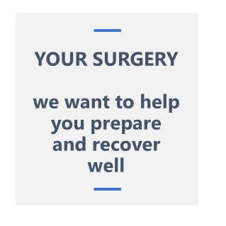
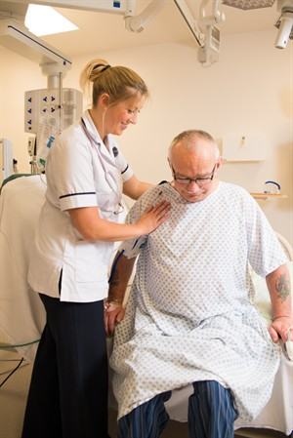
WELCOME

Slide 5
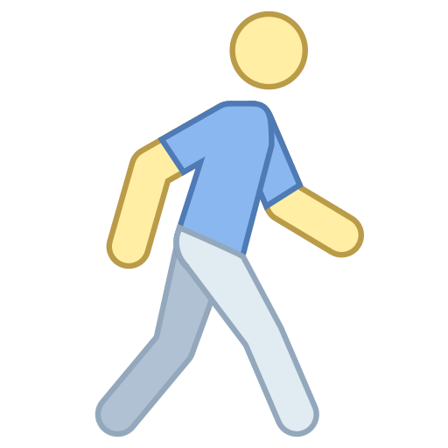
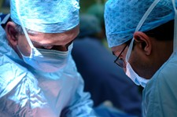
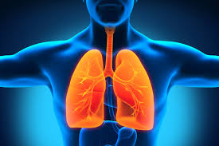
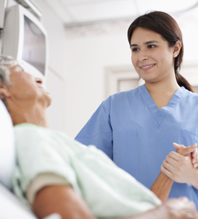
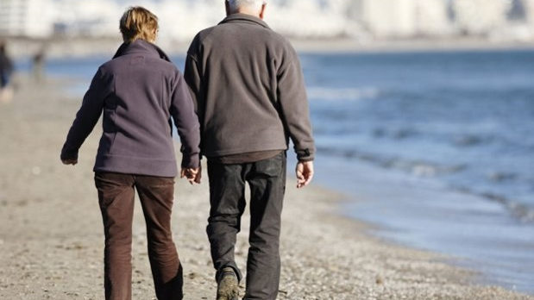
Overview
OUR SERVICES
OUR PORTFOLIO

Slide 6
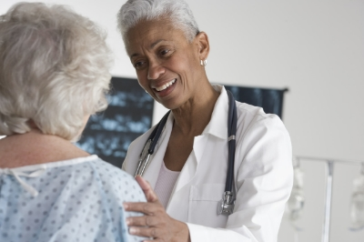


Enhanced Recovery After
Surgery +

Slide 7
Surgery is a body stressor
But we can prepare you for it

Slide 8


ACTIVE
CHEST TRAINING
Surgery is a big thing
for your body
and we need to get you
as fit as possible
Lets get your lungs
fit and ready for
surgery
FAMILY AND
FRIENDS
NUTRITION
Your body is
getting ready for
Surgery - need to
eat well
YOU will benefit
from good support
to help with your prep
and recovery

Slide 9
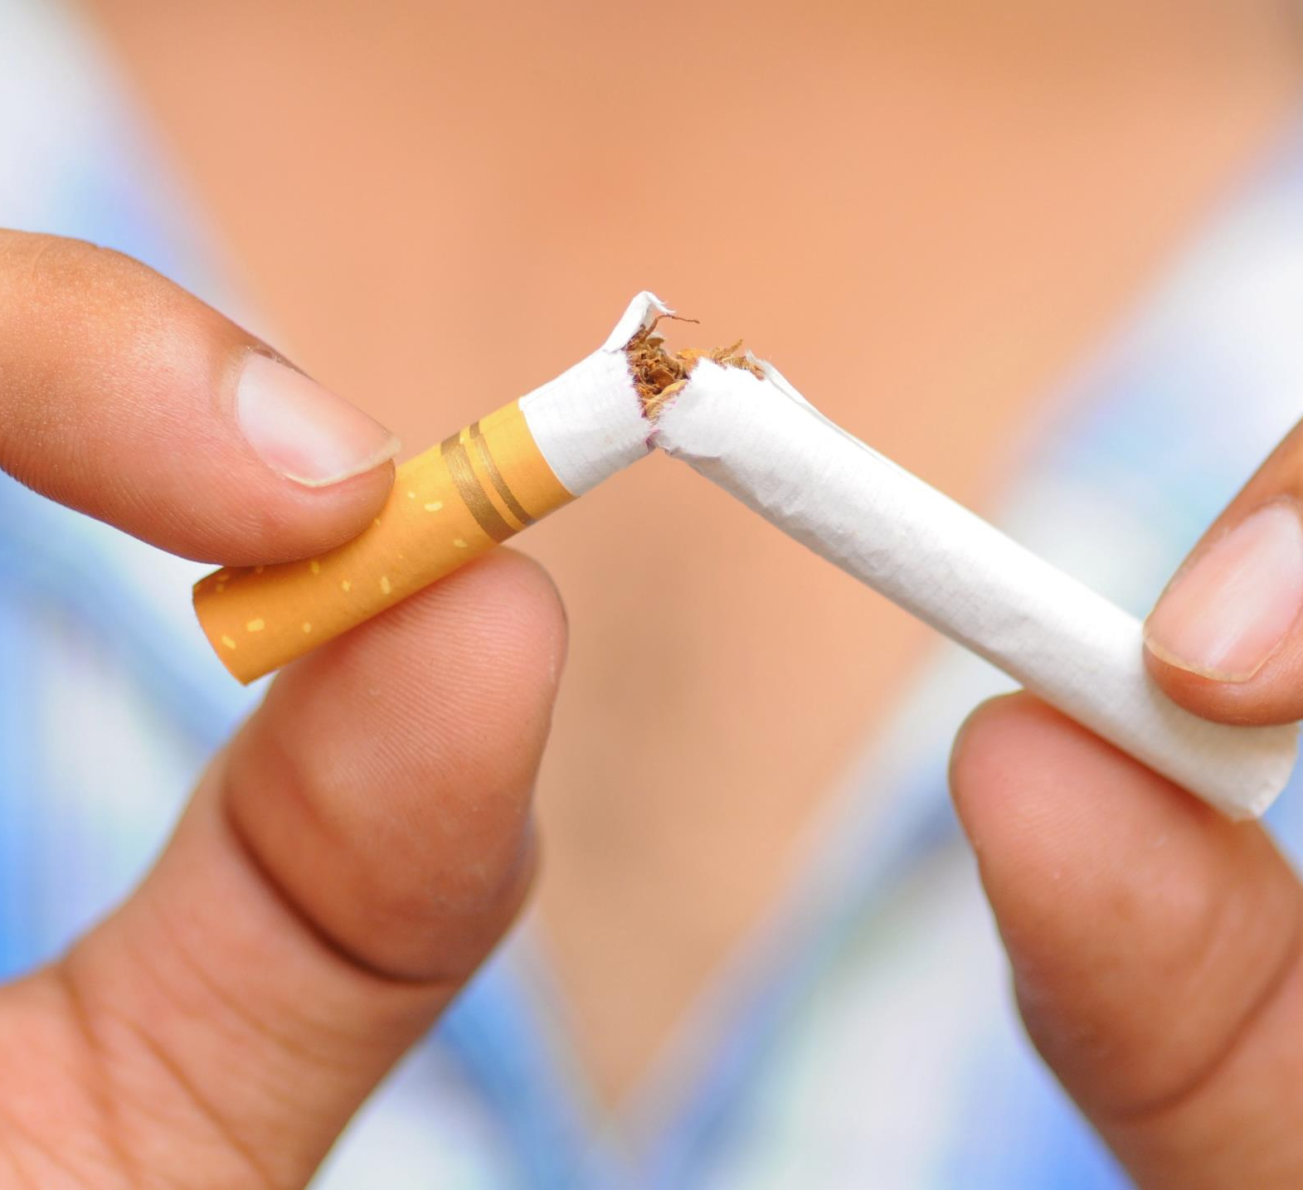
WELL BEING
1
SMOKING
Delays wound healing and causes infections
Increases risk of chest problems
2
ALCOHOL
Causes infection
Suppresses the immune system

Slide 10
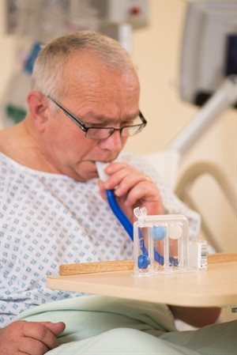

Does it work?
YOU
US
ERAS+
>1000 patients
Over the course of the last decade, however, we seem to have reached a general agreement that creativity

Slide 11
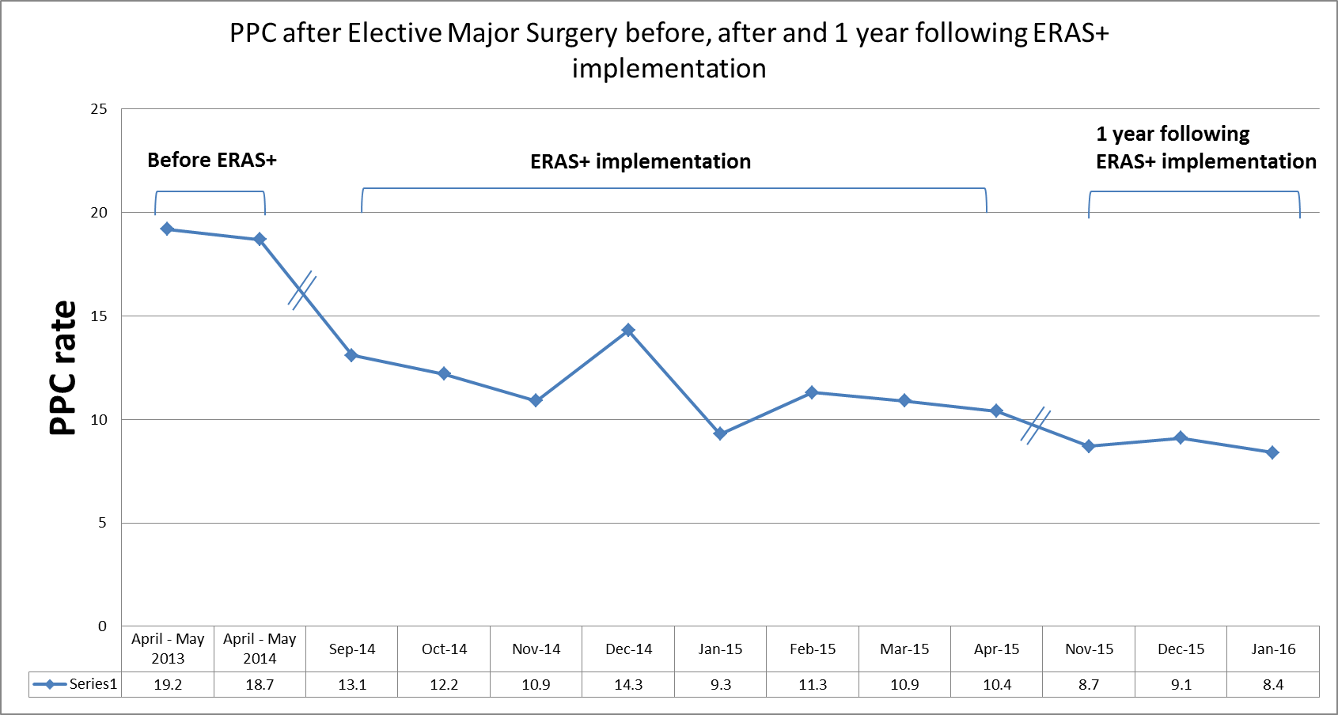

Slide 12

ACTIVITY and
MUSCLE STRENGTHENING
You are training for Surgery
If your body is fitter you’ll do better
If muscles are fitter you recover better
Time to get active

Slide 13
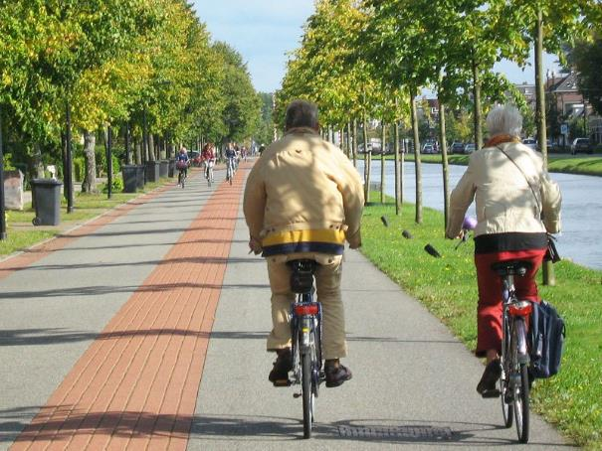
Pre-op Training
weeks before op
ACTIVITY and
MUSCLE STRENGTHENING
Walking
Dancing
Gardening
Cycling
Aim for 20-30 mins activity per day
Time to get active

Slide 14
CHEST TRAINING
You are training your lungs for Surgery
Chest problems are common
Keep lungs big!

Slide 15

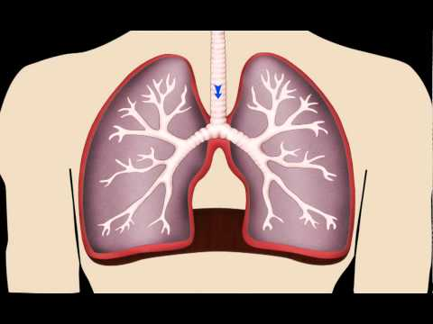
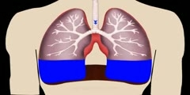
Why do Chest Training?
DAY 3
DAY 7

Slide 16
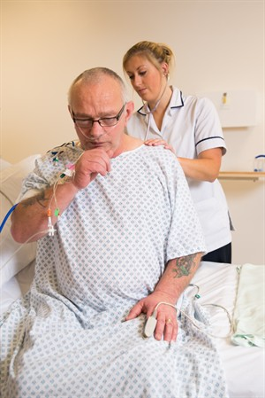
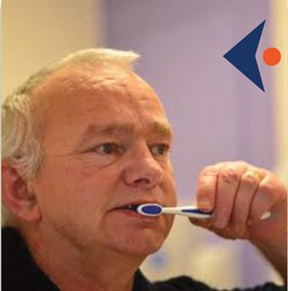
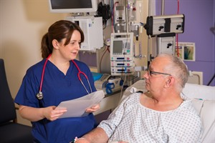
i C o u g h UK
Incentive spirometry
Coughing
Oral Healthcare
Understanding
Getting out of bed
Head of bed elevation
Keeping my lungs big
and clean

Slide 17

Nutrition
Check your weight at least weekly
Eat well
Don’t try and lose weight in the weeks before surgery
We will help you if you’re struggling to maintain your weight
You will be given ‘fuel loading’ prior to surgery

Slide 18
ACTIVE
CHEST TRAINING
Surgery is a big thing
for your body
and we need to get you
as fit as possible
Lets get your lungs
fit and ready for
surgery
FAMILY AND
FRIENDS
NUTRITION
Your body is
getting ready for
Surgery - need to
eat well
YOU will benefit
from good support
to help with your prep
and recovery

Slide 19
Physiotherapy

Slide 20
Pre-op Training
weeks before op
ACTIVITY and
MUSCLE STRENGTHENING
Walking
Dancing
Gardening
Cycling
Aim for 20-30 mins activity per day
Time to get active

Slide 21
After my Surgery
How can I reduce my risk of chest problems’
Mobilise
Good Pain management
Coughing and breathing exercise
Important message:
You need to get out of bed
Support
Tools that allow people or companies to create, share, or exchange information

Slide 22
Nursing

Slide 23
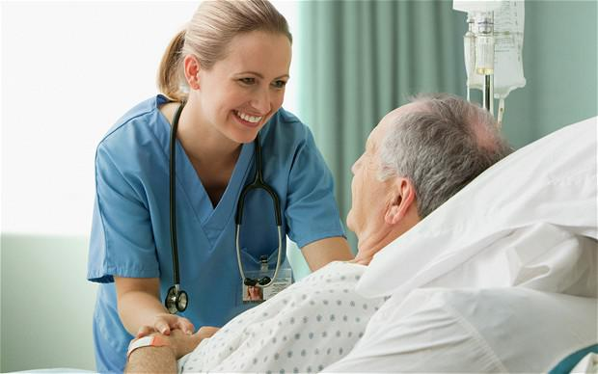
After my Surgery
How do we manage my pain’
Good Pain management is
very important
Allows to mobilise and
keep lungs big!
Score 0 to 10
Important message:
Remember to tell us if you’re in pain
and not ‘To grin and bear it’

Slide 24

After my Surgery
How do we manage my pain’
Epidural
Infusion catheters
Patient controlled analgesia

Slide 25
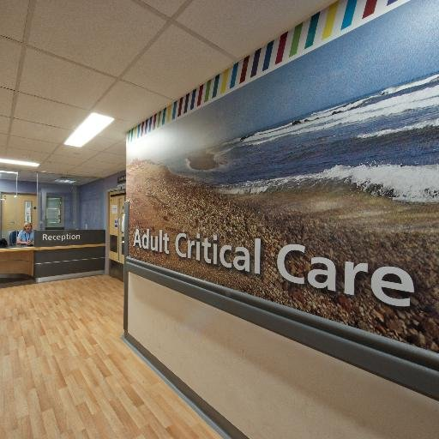
After my Surgery
Critical care’
Visiting 3-8pm every day
Parking
Property – what to bring in
Staff
Male/Female Bays

Slide 26
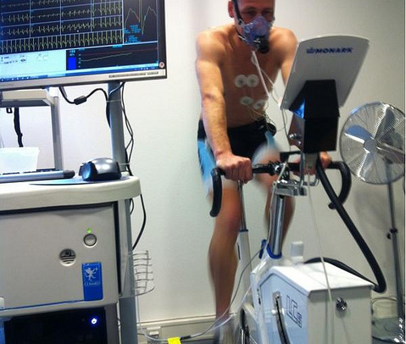
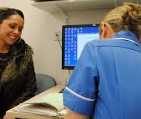
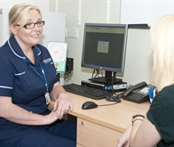
My specialist nurse
Pre-op
assessment
Other tests I may
need to have

Slide 27
Your recovery
Exercise at home
Continue what you were doing when you first went home
Use family and friends for support

Slide 28
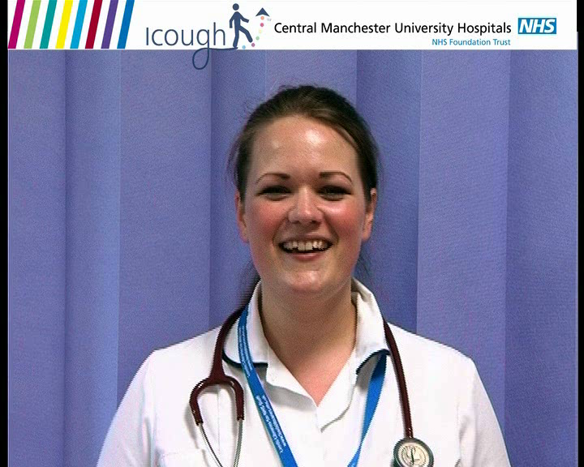
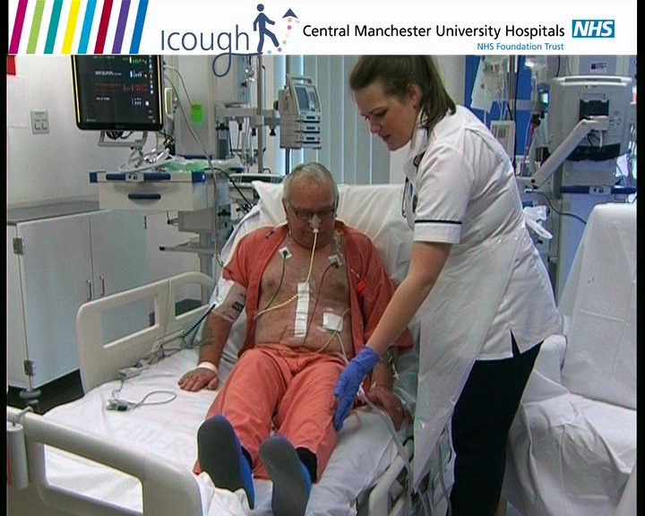
Getting out of
Bed

Slide 29
ACTIVE
CHEST TRAINING
Surgery is a big thing
for your body
and we need to get you
as fit as possible
Lets get your lungs
fit and ready for
surgery
FAMILY AND
FRIENDS
NUTRITION
Your body is
getting ready for
Surgery - need to
eat well
YOU will benefit
from good support
to help with your prep
and recovery

